Slide 1
Lectures 06-10 Logic and Applications Part 1

Slide 2
Intended Learning Outcomes
At the end of the lectures, the student will be able to
Describe Propositional Logic, the Language of Propositions
Apply Propositional Logic
Prove Propositional Equivalences
Describe the need for Predicate Logic and the Language of Quantifiers
Prove Predicate Logic Equivalences
Explain Inference Rules for logical deduction

Slide 3
Topics
Propositional Logic
The Language of Propositions
Applications
Logical Equivalences
Predicate Logic
The Language of Quantifiers
Logical Equivalences
Nested Quantifiers
Inference Rules

Slide 4
Section 1: Propositional Logic

Slide 5
Section Outline
The Language of Propositions
Connectives
Truth Values
Truth Tables
Applications
Translating English Sentences
System Specifications
Boolean Searches
Logic Puzzles
Logical Equivalences
Important Equivalences
Showing Equivalence

Slide 6
Language of Propositions

Slide 7
Outline
Propositions
Connectives
Negation
Conjunction
Disjunction
Implication; contrapositive, inverse, converse
Biconditional
Truth Tables

Slide 8
Propositions
A proposition is a declarative sentence that is either true or false.
Examples of propositions:
The Moon is made of green cheese.
Toronto is the capital of Canada.
Ouagadougou is the capital of Burkina Faso.
1 + 0 = 1
0 + 0 = 2
Examples of sentences that are not propositions.
Sit down!
What time is it?
x + 1 = 2
x + y = z

Slide 9
Propositional Logic
Constructing Propositions
Propositional Variables: p, q, r, s, …
The proposition that is always true is denoted by T and the proposition that is always false is denoted by F.
Compound Propositions; constructed from logical connectives and other propositions
Negation ¬
Conjunction ∧
Disjunction ∨
Implication →
Biconditional ↔

Slide 10
Compound Propositions: Negation
The negation of a proposition p is denoted by ¬p and has this truth table:
Example: If p denotes “The earth is round.”, then ¬p denotes “It is not the case that the earth is round,” or more simply “The earth is not round.”
P | ¬p
T | F
F | T

Slide 11
Conjunction
The conjunction of propositions p and q is denoted by p ∧ q and has this truth table:
Example: If p denotes “I am at home.” and q denotes “It is raining.” then p ∧q denotes “I am at home and it is raining.”
p | q | p ∧ q
T | T | T
T | F | F
F | T | F
F | F | F

Slide 12
Disjunction
The disjunction of propositions p and q is denoted by p ∨q and has this truth table:
Example: If p denotes “I am at home.” and q denotes “It is raining.” then p ∨q denotes “I am at home or it is raining.”
p | q | p ∨q
T | T | T
T | F | T
F | T | T
F | F | F

Slide 13
The Connective Or in English
In English “or” has two distinct meanings.
“Inclusive Or” - In the sentence “Students who have taken CS1027 or Math1600 may take this class,” we assume that students need to have taken one of the prerequisites, but may have taken both. This is the meaning of disjunction. For p ∨q to be true, either one or both of p and q must be true.
“Exclusive Or” - When reading the sentence “Soup or salad comes with this entrée,” we do not expect to be able to get both soup and salad. This is the meaning of Exclusive Or (Xor). In p ⊕ q , one of p and q must be true, but not both. The truth table for ⊕ is:
p | q | p ⊕q
T | T | F
T | F | T
F | T | T
F | F | F

Slide 14
Implication
If p and q are propositions, then p →q is a conditional statement or implication which is read as “if p, then q ” and has this truth table:
Example: If p denotes “I am at home.” and q denotes “It is raining.” then p →q denotes “If I am at home then it is raining.”
In p →q , p is the hypothesis (antecedent or premise) and q is the conclusion (or consequence).
p | q | p →q
T | T | T
T | F | F
F | T | T
F | F | T

Slide 15
Understanding Implication
In p →q there does not need to be any connection between the antecedent or the consequent. The “meaning” of p →q depends only on the truth values of p and q.
These implications are perfectly fine, but would not be used in ordinary English.
“If the moon is made of green cheese, then I have more money than Bill Gates. ”
“If the moon is made of green cheese then I’m on welfare.”
“If 1 + 1 = 3, then your grandma wears combat boots.”

Slide 16
Understanding Implication
One way to view the logical conditional is to think of an obligation or contract.
“If I am elected, then I will lower taxes.”
“If you get 100% on the final, then you will get an A.”
If the politician is elected and does not lower taxes, then the voters can say that he or she has broken the campaign pledge. Something similar holds for the professor. This corresponds to the case where p is true and q is false.

Slide 17
Different Ways of Expressing p →q
if p, then q p implies q
if p, q p only if q
q unless ¬p q when p
q if p q when p
q whenever p p is sufficient for q
q follows from p q is necessary for p
a necessary condition for p is q
a sufficient condition for q is p

Slide 18
Converse, Contrapositive, and Inverse
From p →q we can form new conditional statements .
q →p is the converse of p →q
¬q → ¬ p is the contrapositive of p →q
¬ p → ¬ q is the inverse of p →q
Example: Find the converse, inverse, and contrapositive of “It raining is a sufficient condition for my not going to town.”

Slide 19
Converse, Contrapositive, and Inverse
From p →q we can form new conditional statements .
q →p is the converse of p →q
¬q → ¬ p is the contrapositive of p →q
¬ p → ¬ q is the inverse of p →q
Example: Find the converse, inverse, and contrapositive of “It raining is a sufficient condition for my not going to town.”
Solution:
converse: If I do not go to town, then it is raining.
inverse: If it is not raining, then I will go to town.
contrapositive: If I go to town, then it is not raining.

Slide 20
Biconditional
If p and q are propositions, then we can form the biconditional proposition p ↔q , read as “p if and only if q .” The biconditional p ↔q denotes the proposition with this truth table:
If p denotes “I am at home.” and q denotes “It is raining.” then p ↔q denotes “I am at home if and only if it is raining.”
p | q | p ↔q
T | T | T
T | F | F
F | T | F
F | F | T

Slide 21
Expressing the Biconditional
Some alternative ways “p if and only if q” is expressed in English:
p is necessary and sufficient for q
if p then q , and conversely
p iff q

Slide 22
Truth Tables For Compound Propositions
Construction of a truth table:
Rows
Need a row for every possible combination of values for the atomic propositions.
Columns
Need a column for the compound proposition (usually at far right)
Need a column for the truth value of each expression that occurs in the compound proposition as it is built up.
This includes the atomic propositions

Slide 23
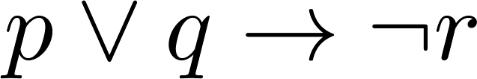
Example Truth Table
Construct a truth table for
p | q | r | ¬r | p ∨ q | p ∨ q → ¬r
T | T | T | F | T | F
T | T | F | T | T | T
T | F | T | F | T | F
T | F | F | T | T | T
F | T | T | F | T | F
F | T | F | T | T | T
F | F | T | F | F | T
F | F | F | T | F | T

Slide 24
Equivalent Propositions
Two propositions are equivalent if they always have the same truth value.
Example: Show using a truth table that the conditional is equivalent to the contrapositive.

Slide 25
Equivalent Propositions
Two propositions are equivalent if they always have the same truth value.
Example: Show using a truth table that the conditional is equivalent to the contrapositive.
Solution:
p | q | ¬ p | ¬ q | p →q | ¬q → ¬ p
T | T | F | F | T | T
T | F | F | T | F | F
F | T | T | F | T | T
F | F | T | T | T | T

Slide 26
Using a Truth Table to Show Non-Equivalence
Example: Show using truth tables that neither the converse nor inverse of an implication are not equivalent to the implication.

Slide 27
Using a Truth Table to Show Non-Equivalence
Example: Show using truth tables that neither the converse nor inverse of an implication are not equivalent to the implication.
Solution:
p | q | ¬ p | ¬ q | p →q | ¬ p →¬ q | q → p
T | T | F | F | T | T | T
T | F | F | T | F | T | T
F | T | T | F | T | F | F
F | F | T | T | F | T | T

Slide 28
Problem
How many rows are there in a truth table with n propositional variables?

Slide 29
Height of the Truth Table
How many rows are there in a truth table with n propositional variables?
Solution: 2^{n} We will see how to do this later.
Note that this means that with n propositional variables, we can construct 2^{n} distinct (i.e., not equivalent) propositions.

Slide 30
Precedence of Logical Operators
Operator | Precedence
¬ | 1
∧ ∨ | 2 3
→ ↔ | 4 5
p ∨q → ¬r is equivalent to (p ∨q) → ¬r
If the intended meaning is p ∨(q → ¬r ) then parentheses must be used.

Slide 31
Applications of Propositional Logic

Slide 32
Outline
Translating English to Propositional Logic
System Specifications
Boolean Searches
Logic Puzzles

Slide 33
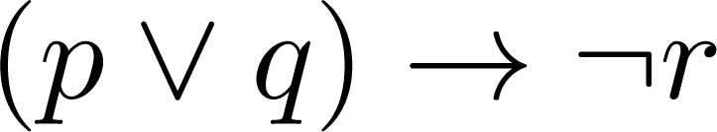
Translating English Sentences
Steps to convert an English sentence to a statement in propositional logic
Identify atomic propositions and represent using propositional variables.
Determine appropriate logical connectives
“If I go to Harry’s or to the country, I will not go shopping.”
p: I go to Harry’s
q: I go to the country.
r: I will go shopping.
If p or q then not r.

Slide 34
Translating English Sentences
Problem: Translate the following sentence into propositional logic:
“You can access the Internet from campus only if you are a computer science major or you are not a freshman.”

Slide 35
Translating English Sentences
Problem: Translate the following sentence into propositional logic:
“You can access the Internet from campus only if you are a computer science major or you are not a freshman.”
One Solution: Let a, c, and f represent respectively “You can access the internet from campus,” “You are a computer science major,” and “You are a freshman.”
a→ (c ∨ ¬ f )

Slide 36
System Specifications
System and Software engineers take requirements in English and express them in a precise specification language based on logic.
Example: Express in propositional logic:
“The automated reply cannot be sent when the file system is full”

Slide 37
System Specifications
Example: Express in propositional logic:
“The automated reply cannot be sent when the file system is full”
Solution: One possible solution: Let p denote “The automated reply can be sent” and q denote “The file system is full.”
q→ ¬ p

Slide 38
Consistent System Specifications
Definition: A list of propositions is consistent if it is possible to assign truth values to the proposition variables so that each proposition is true.
Exercise: Are these specifications consistent?
“The diagnostic message is stored in the buffer or it is retransmitted.”
“The diagnostic message is not stored in the buffer.”
“If the diagnostic message is stored in the buffer, then it is retransmitted.”

Slide 39
Consistent System Specifications
Exercise: Are these specifications consistent?
“The diagnostic message is stored in the buffer or it is retransmitted.”
“The diagnostic message is not stored in the buffer.”
“If the diagnostic message is stored in the buffer, then it is retransmitted.”
Solution: Let p denote “The diagnostic message is stored in the buffer.” Let q denote “The diagnostic message is retransmitted” The specification can be written as: p ∨ q, p→ q, ¬p.
When p is false and q is true all three statements are true. So the specification is consistent.
What if “The diagnostic message is not retransmitted” is added?

Slide 40
Consistent System Specifications
Exercise: Are these specifications consistent?
“The diagnostic message is stored in the buffer or it is retransmitted.”
“The diagnostic message is not stored in the buffer.”
“If the diagnostic message is stored in the buffer, then it is retransmitted.”
Solution: Let p denote “The diagnostic message is not stored in the buffer.” Let q denote “The diagnostic message is retransmitted” The specification can be written as: p ∨ q, p→ q, ¬p. When p is false and q is true all three statements are true. So the specification is consistent.
What if “The diagnostic message is not retransmitted” is added?
Solution: Now we are adding ¬q and there is no satisfying assignment. So the specification is not consistent.

Slide 41
Boolean Searches
Logical connectives are used extensively in searches of large collections of information, such as indexes of webpages: Such searches are called Boolean Searches
The connective AND is used to match records that contain both of the two search terms
The connective OR is used to match one or both of the search terms
The connective NOT (sometimes written as
AND NOT) is used to exclude a search term

Slide 42
Web Page Searching
Most Web search engines support Boolean searching techniques
Using Boolean searching to find Web pages about
universities in British Columbia we can look for pages matching
British AND Columbia AND Universities
The AND operator: Note that in Google the word “AND” is not needed, although it is implicit
Google also supports the use of quotation marks to search for specific phrases: It may be more effective to search for
“British Columbia” Universities

Slide 43
Web Page Searching
The OR operator: In Google “The OR operator, for which you may also use | (vertical bar), applies to the search terms immediately adjacent to it.”
In Google, the terms used for searching olympics locations for 2014 or 2018 would be
olympics 2014 OR 2018
olympics 2014 | 2018
interpreted as olympics AND (2014 OR 2018)
To find universities in British Columbia or Ontario we would use
“British Columbia” OR Ontario universities
The NOT operator: To find webpages that deal with universities in Columbia (but not in British Columbia) we search for
(Columbia AND Universities) NOT British
In Google, the word NOT is replaced by the symbol “-” (minus)
Columbia Universities -British

Slide 44
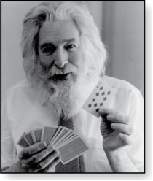
Logic Puzzles
An island has two kinds of inhabitants, knights, who always tell the truth, and knaves, who always lie.
You go to the island and meet A and B.
A says “B is a knight.”
B says “The two of us are of opposite types.”
Puzzle : What are the types of A and B?
Raymond Smullyan
(Born 1919)

Slide 45
Logic Puzzles
An island has two kinds of inhabitants, knights, who always tell the truth, and knaves, who always lie.
You go to the island and meet A and B.
A says “B is a knight.”
B says “The two of us are of opposite types.”
Puzzle : What are the types of A and B?
Solution: Let p and q be the statements that A is a knight and B is a knight, respectively. So, then ¬p represents the proposition that A is a knave and ¬q that B is a knave.
If A is a knight, then p is true. Since knights tell the truth, q must also be true. Then (p ∧ ¬ q)∨ (¬ p ∧ q) would have to be true, but it is not. So, A is not a knight and therefore ¬p must be true and we explore that possibility.
If A is a knave, then B must not be a knight since knaves always lie. So, then both ¬p and ¬q hold, and thus both are knaves.

Slide 46
Propositional Equivalences

Slide 47
Outline
Tautologies, Contradictions, and Contingencies
Logical Equivalence
Important Logical Equivalences
Showing Logical Equivalence

Slide 48
Tautologies, Contradictions and Contingencies
A tautology is a proposition which is always true.
Example: p ∨¬p
A contradiction is a proposition which is always false.
Example: p ∧¬p
A contingency is a proposition which is neither a tautology nor a contradiction, such as p
P | ¬p | p ∨¬p | p ∧¬p
T | F | T | F
F | T | T | F

Slide 49
Logically Equivalent
Two compound propositions p and q are logically equivalent if p↔q is a tautology.
We write this as p⇔q or as p≡q where p and q are compound propositions.
Two compound propositions p and q are equivalent if and only if the columns in a truth table giving their truth values agree.
This truth table show ¬p ∨ q is equivalent to p → q
p | q | ¬p | ¬p ∨ q | p→ q
T | T | F | T | T
T | F | F | F | F
F | T | T | T | T
F | F | T | T | T

Slide 50
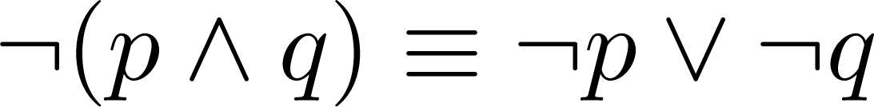
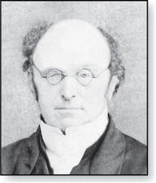
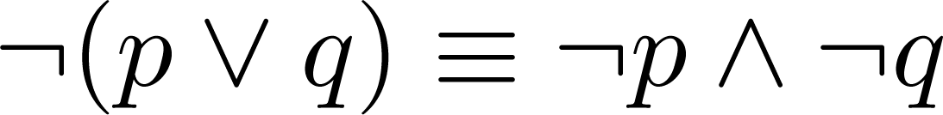
De Morgan’s Laws
Augustus De Morgan
1806-1871

Slide 51
De Morgan’s Laws
This truth table shows that De Morgan’s Second Law holds.
p | q | ¬p | ¬q | (p∨q) | ¬(p∨q) | ¬p∧¬q
T | T | F | F | T | F | F
T | F | F | T | T | F | F
F | T | T | F | T | F | F
F | F | T | T | F | T | T

Slide 52
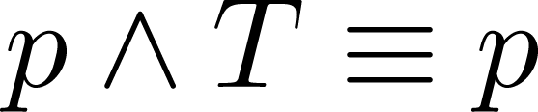
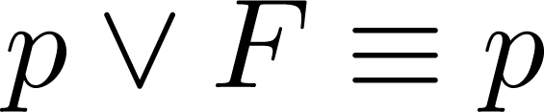
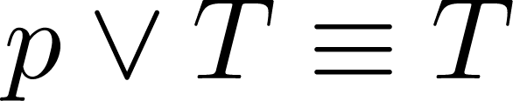
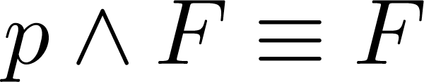
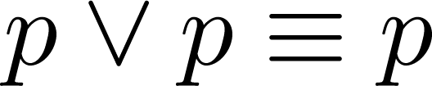
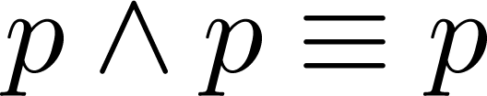
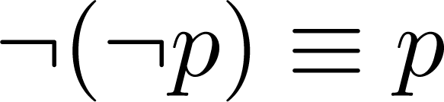
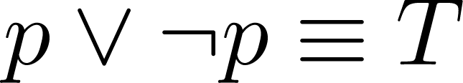
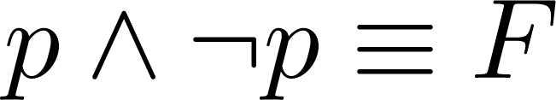
Key Logical Equivalences
Identity Laws:
Domination Laws:
Idempotent laws:
Double Negation Law:
Negation Laws:

Slide 53
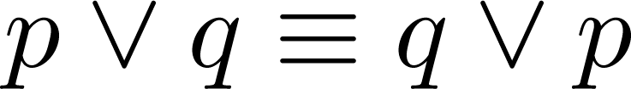
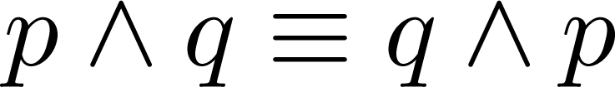
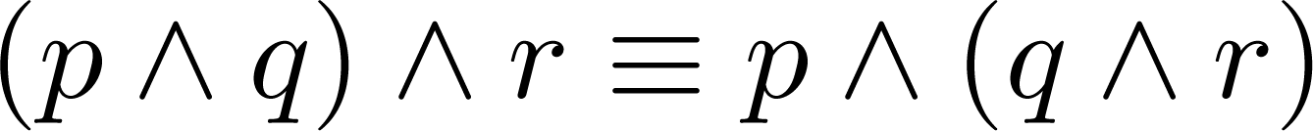
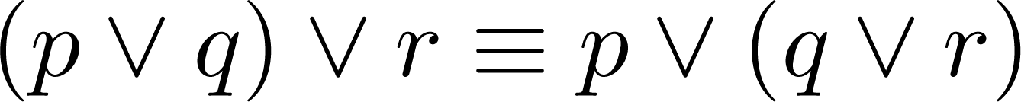
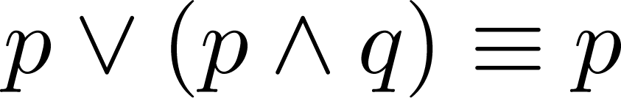
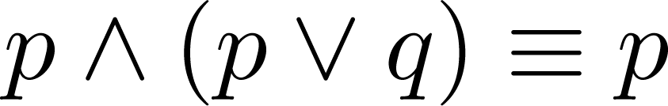
Key Logical Equivalences
Commutative Laws:
Associative Laws:
Distributive Laws:
Absorption Laws:

Slide 54
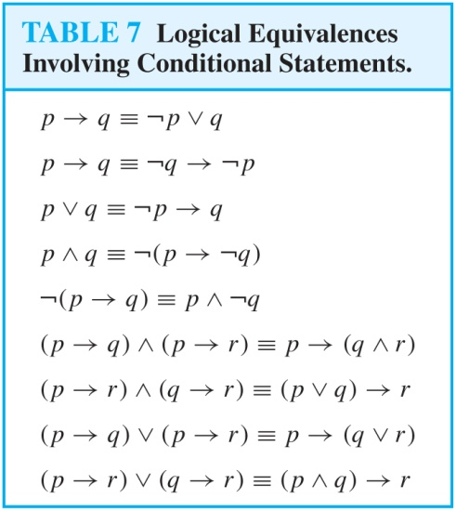
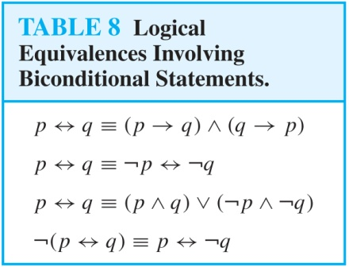
More Logical Equivalences

Slide 55

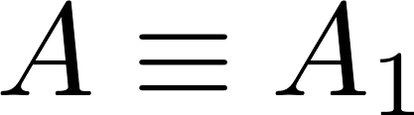
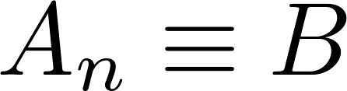
Constructing New Logical Equivalences
We can show that two expressions are logically equivalent by developing a series of logically equivalent statements.
To prove that we produce a series of equivalences beginning with A and ending with B.
Keep in mind that whenever a proposition (represented by a propositional variable) occurs in the equivalences listed earlier, it may be replaced by an arbitrarily complex compound proposition.

Slide 56
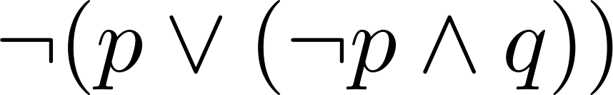
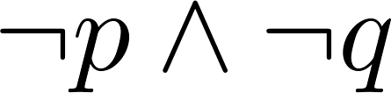
Equivalence Proofs
Example: Show that
is logically equivalent to

Slide 57
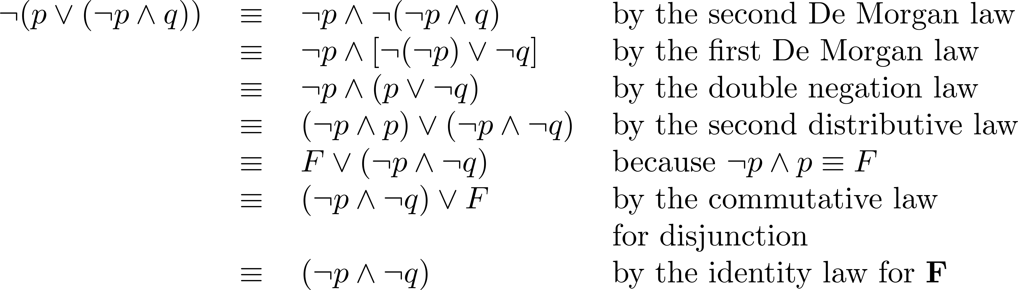
Equivalence Proofs
Example: Show that
is logically equivalent to
Solution:

Slide 58
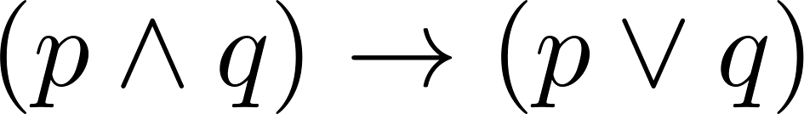
Equivalence Proofs
Example: Show that
is a tautology.

Slide 59
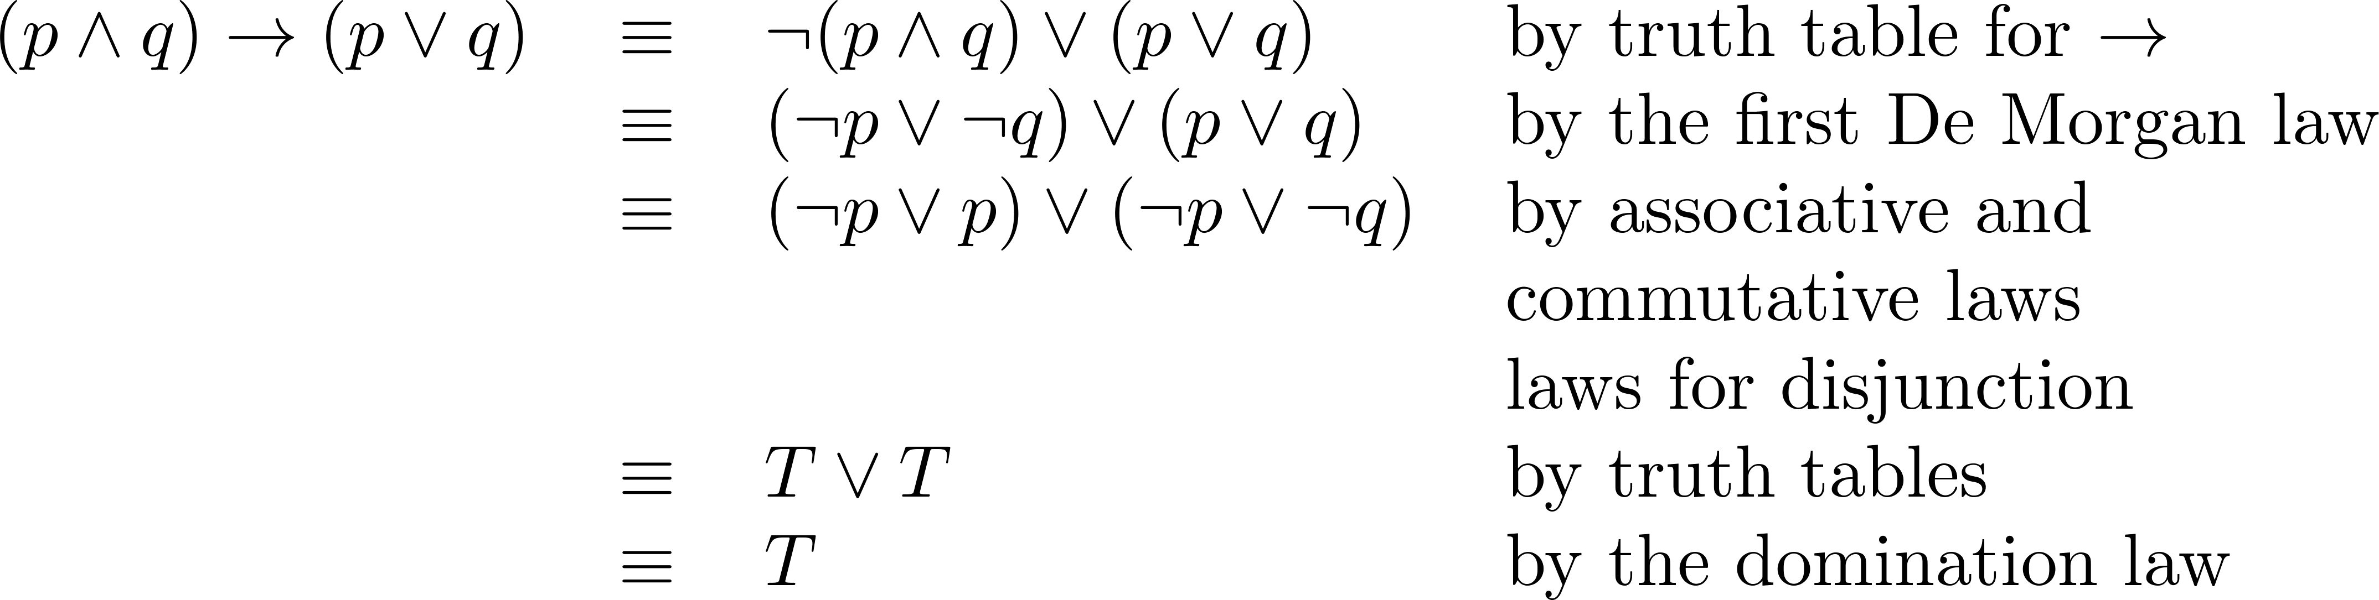
Equivalence Proofs
Example: Show that
is a tautology.
Solution:

Slide 60
Section 2: Predicate Logic

Slide 61
Section Outline
Predicate Logic (First-Order Logic (FOL), Predicate Calculus)
The Language of Quantifiers
Logical Equivalences
Nested Quantifiers
Translation from Predicate Logic to English
Translation from English to Predicate Logic

Slide 62
Predicates and Quantifiers

Slide 63
Outline
Predicates
Variables
Quantifiers
Universal Quantifier
Existential Quantifier
Negating Quantifiers
De Morgan’s Laws for Quantifiers
Translating English to Logic

Slide 64
Propositional Logic Not Enough
If we have:
“All men are mortal.”
“Socrates is a man.”
Does it follow that “Socrates is mortal?”
Can’t be represented in propositional logic. Need a language that talks about objects, their properties, and their relations.
Later we’ll see how to draw inferences.

Slide 65
Introducing Predicate Logic
Predicate logic uses the following new features:
Variables: x, y, z
Predicates: P(x), M(x)
Quantifiers
Propositional functions are a generalization of propositions.
They contain variables and a predicate, e.g., P(x)
Variables can be replaced by elements from their domain.

Slide 66
Propositional Functions
Propositional functions become propositions (and have truth values) when their variables are each replaced by a value from the domain (or bound by a quantifier, as we will see later).
The statement P(x) is said to be the value of the propositional function P at x.
For example, let P(x) denote “x > 0” and the domain be the integers. Then:
P(-3) is false.
P(0) is false.
P(3) is true.
Often the domain is denoted by U. So in this example U is the integers.

Slide 67
Examples of Propositional Functions
Let “x + y = z” be denoted by R(x, y, z) and U (for all three variables) be the integers. Find these truth values:
R(2,-1,5)
R(3,4,7)
R(x, 3, z)
Now let “x - y = z” be denoted by Q(x, y, z), with U as the integers. Find these truth values:
Q(2,-1,3)
Q(3,4,7)
Q(x, 3, z)

Slide 68
Examples of Propositional Functions
Let “x + y = z” be denoted by R(x, y, z) and U (for all three variables) be the integers. Find these truth values:
R(2,-1,5)
Solution: F
R(3,4,7)
Solution: T
R(x, 3, z)
Solution: Not a Proposition
Now let “x - y = z” be denoted by Q(x, y, z), with U as the integers. Find these truth values:
Q(2,-1,3)
Solution: T
Q(3,4,7)
Solution: F
Q(x, 3, z)
Solution: Not a Proposition

Slide 69
Compound Expressions
Connectives from propositional logic carry over to predicate logic.
If P(x) denotes “x > 0,” find these truth values:
P(3) ∨ P(-1)
P(3) ∧ P(-1)
P(3) → P(-1)
P(3) → P(-1)
Expressions with variables are not propositions and therefore do not have truth values. For example,
P(3) ∧ P(y)
P(x) → P(y)
When used with quantifiers (to be introduced next), these expressions (propositional functions) become propositions.

Slide 70
Compound Expressions
Connectives from propositional logic carry over to predicate logic.
If P(x) denotes “x > 0,” find these truth values:
P(3) ∨ P(-1) Solution: T
P(3) ∧ P(-1) Solution: F
P(3) → P(-1) Solution: F
P(3) → P(-1) Solution: T
Expressions with variables are not propositions and therefore do not have truth values. For example,
P(3) ∧ P(y)
P(x) → P(y)
When used with quantifiers (to be introduced next), these expressions (propositional functions) become propositions.

Slide 71
Quantifiers
We need quantifiers to express the meaning of English words including all and some:
“All men are Mortal.”
“Some cats do not have fur.”
The two most important quantifiers are:
Universal Quantifier, “For all,” symbol: ∀
Existential Quantifier, “There exists,” symbol: ∃
We write as in ∀x P(x) and ∃x P(x).
∀x P(x) asserts P(x) is true for every x in the domain.
∃x P(x) asserts P(x) is true for some x in the domain.
The quantifiers are said to bind the variable x in these expressions.

Slide 72
Universal Quantifier
∀x P(x) is read as “For all x, P(x)” or “For every x, P(x)”
Examples:
If P(x) denotes “x > 0” and U is the integers, then ∀x P(x) is false.
If P(x) denotes “x > 0” and U is the positive integers, then ∀x P(x) is true.
If P(x) denotes “x is even” and U is the integers, then
∀ x P(x) is false.

Slide 73
Existential Quantifier
∃x P(x) is read as “For some x, P(x)”, or as “There is an x such that P(x),” or “For at least one x, P(x).”
Examples:
If P(x) denotes “x > 0” and U is the integers, then ∃x P(x) is true. It is also true if U is the positive integers.
If P(x) denotes “x < 0” and U is the positive integers, then ∃x P(x) is false.
If P(x) denotes “x is even” and U is the integers, then
∃x P(x) is true.

Slide 74
Thinking about Quantifiers
When the domain of discourse is finite, we can think of quantification as looping through the elements of the domain.
To evaluate ∀x P(x) loop through all x in the domain.
If at every step P(x) is true, then ∀x P(x) is true.
If at a step P(x) is false, then ∀x P(x) is false and the loop terminates.
To evaluate ∃x P(x) loop through all x in the domain.
If at some step, P(x) is true, then ∃x P(x) is true and the loop terminates.
If the loop ends without finding an x for which P(x) is true,
then ∃x P(x) is false.
Even if the domains are infinite, we can still think of the quantifiers this fashion, but the loops will not terminate in some cases.

Slide 75
Properties of Quantifiers
The truth value of ∃x P(x) and ∀ x P(x) depend on both the propositional function P(x) and on the domain U.
Examples:
If U is the positive integers and P(x) is the statement “x < 2”, then ∃x P(x) is ?, and ∀ x P(x) is ?.
If U is the negative integers and P(x) is the statement “x < 2”, then ∃x P(x) is ?, and ∀ x P(x) is ?.
If U consists of 3, 4, and 5, and P(x) is the statement “x > 2”, then ∃x P(x) is ?, and ∀ x P(x) is ? . But if P(x) is the statement “x < 2”, then ∃x P(x) is ?, and ∀ x P(x) is ?

Slide 76
Properties of Quantifiers
The truth value of ∃x P(x) and ∀ x P(x) depend on both the propositional function P(x) and on the domain U.
Examples:
If U is the positive integers and P(x) is the statement “x < 2”, then ∃x P(x) is true, but ∀ x P(x) is false.
If U is the negative integers and P(x) is the statement “x < 2”, then both ∃x P(x) and ∀ x P(x) are true.
If U consists of 3, 4, and 5, and P(x) is the statement “x > 2”, then both ∃x P(x) and ∀ x P(x) are true. But if P(x) is the statement “x < 2”, then both ∃x P(x) and ∀ x P(x) are false.

Slide 77
Precedence of Quantifiers
The quantifiers ∀ and ∃ have higher precedence than all the logical operators.
For example, ∀x P(x) ∨ Q(x) means (∀x P(x))∨ Q(x)
∀x (P(x) ∨ Q(x)) means something different.
Unfortunately, often people write ∀x P(x) ∨ Q(x) when they mean ∀ x (P(x) ∨ Q(x)).

Slide 78
Translating from English to Logic
Example 1: Translate the following sentence into predicate logic: “Every student in this class has taken a course in Java.”

Slide 79
Translating from English to Logic
Example 1: Translate the following sentence into predicate logic: “Every student in this class has taken a course in Java.”
Solution:
First decide on the domain U.
Solution 1: If U is all students in this class, define a propositional function J(x) denoting “x has taken a course in Java” and translate as ∀x J(x).
Solution 2: But if U is all people, also define a propositional function S(x) denoting “x is a student in this class” and translate as ∀x (S(x)→ J(x)).
∀x (S(x) ∧ J(x)) is not correct. What does it mean?

Slide 80
Translating from English to Logic
Example 2: Translate the following sentence into predicate logic: “Some student in this class has taken a course in Java.”

Slide 81
Translating from English to Logic
Example 2: Translate the following sentence into predicate logic: “Some student in this class has taken a course in Java.”
Solution:
First decide on the domain U.
Solution 1: If U is all students in this class, translate as
∃x J(x)
Solution 1: But if U is all people, then translate as ∃x (S(x) ∧ J(x))
∃x (S(x)→ J(x)) is not correct. What does it mean?

Slide 82
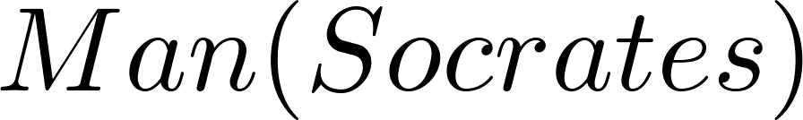
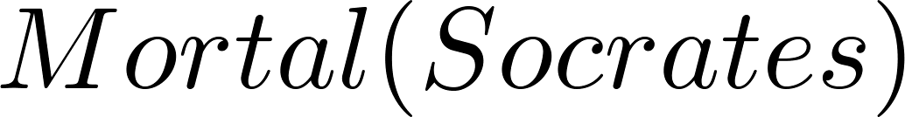
Returning to the Socrates Example
Introduce the propositional functions Man(x) denoting “x is a man” and Mortal(x) denoting “x is mortal.” Specify the domain as all people.
The two premises are:
The conclusion is:

Slide 83
Equivalences in Predicate Logic
Statements involving predicates and quantifiers are logically equivalent if and only if they have the same truth value
For every predicate substituted into these statements and
For every domain of discourse used for the variables in the expressions.
The notation S ≡T indicates that S and T are logically equivalent.
Example: ∀x ¬¬S(x) ≡ ∀x S(x)

Slide 84
Thinking about Quantifiers as Conjunctions and Disjunctions
If the domain is finite, a universally quantified proposition is equivalent to a conjunction of propositions without quantifiers and an existentially quantified proposition is equivalent to a disjunction of propositions without quantifiers.
If U consists of the integers 1,2, and 3:
Even if the domains are infinite, you can still think of the quantifiers in this fashion, but the equivalent expressions without quantifiers will be infinitely long.

Slide 85
Negating Quantified Expressions
Consider ∀x J(x)
“Every student in your class has taken a course in Java.”
Here J(x) is “x has taken a course in Java” and
the domain is students in your class.
Negating the original statement gives “It is not the case that every student in your class has taken Java.” This implies that “There is a student in your class who has not taken Java.”
Symbolically ¬∀x J(x) and ∃x ¬J(x) are equivalent

Slide 86
Negating Quantified Expressions
Now consider ∃ x J(x)
“There is a student in this class who has taken a course in Java.”
Where J(x) is “x has taken a course in Java.”
Negating the original statement gives “It is not the case that there is a student in this class who has taken Java.” This implies that “Every student in this class has not taken Java”
Symbolically ¬∃ x J(x) and ∀ x ¬J(x) are equivalent

Slide 87
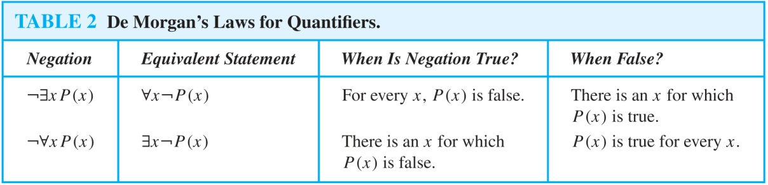
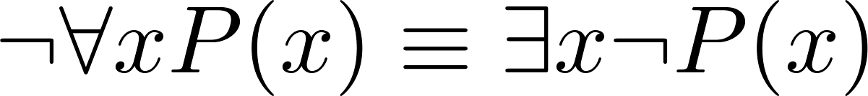
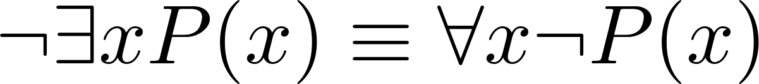
De Morgan’s Laws for Quantifiers
The rules for negating quantifiers are:
The reasoning in the table shows that:
These are important. We will use these.

Slide 88
Translation from English to Logic
Examples:
“Some student in this class has visited Mexico.”
“Every student in this class has visited Canada or Mexico.”

Slide 89
Translation from English to Logic
Examples:
“Some student in this class has visited Mexico.”
Solution: Let M(x) denote “x has visited Mexico” and S(x) denote “x is a student in this class,” and U be all people.
∃x (S(x) ∧ M(x))
“Every student in this class has visited Canada or Mexico.”
Solution: Add C(x) denoting “x has visited Canada.”
∀x (S(x)→ (M(x)∨C(x)))

Slide 90
Some Fun with Translating from English into Logical Expressions
U = {fleegles, snurds, thingamabobs}
F(x): x is a fleegle
S(x): x is a snurd
T(x): x is a thingamabob
Translate “Everything is a fleegle”

Slide 91
Some Fun with Translating from English into Logical Expressions
U = {fleegles, snurds, thingamabobs}
F(x): x is a fleegle
S(x): x is a snurd
T(x): x is a thingamabob
Translate “Everything is a fleegle”
Solution: ∀x F(x)

Slide 92
Translation (cont)
U = {fleegles, snurds, thingamabobs}
F(x): x is a fleegle
S(x): x is a snurd
T(x): x is a thingamabob
Translate “Nothing is a snurd.”

Slide 93
Translation (cont)
U = {fleegles, snurds, thingamabobs}
F(x): x is a fleegle
S(x): x is a snurd
T(x): x is a thingamabob
“Nothing is a snurd.”
Solution: ¬∃x S(x) What is this equivalent to?
Solution: ∀x ¬ S(x)

Slide 94
Translation (cont)
U = {fleegles, snurds, thingamabobs}
F(x): x is a fleegle
S(x): x is a snurd
T(x): x is a thingamabob
Translate “All fleegles are snurds.”

Slide 95
Translation (cont)
U = {fleegles, snurds, thingamabobs}
F(x): x is a fleegle
S(x): x is a snurd
T(x): x is a thingamabob
“All fleegles are snurds.”
Solution: ∀x (F(x)→ S(x))

Slide 96
Translation (cont)
U = {fleegles, snurds, thingamabobs}
F(x): x is a fleegle
S(x): x is a snurd
T(x): x is a thingamabob
Translate “Some fleegles are thingamabobs.”

Slide 97
Translation (cont)
U = {fleegles, snurds, thingamabobs}
F(x): x is a fleegle
S(x): x is a snurd
T(x): x is a thingamabob
“Some fleegles are thingamabobs.”
Solution: ∃x (F(x) ∧ T(x))

Slide 98
Translation (cont)
U = {fleegles, snurds, thingamabobs}
F(x): x is a fleegle
S(x): x is a snurd
T(x): x is a thingamabob
Translate “No snurd is a thingamabob.”

Slide 99
Translation (cont)
U = {fleegles, snurds, thingamabobs}
F(x): x is a fleegle
S(x): x is a snurd
T(x): x is a thingamabob
“No snurd is a thingamabob.”
Solution: ¬∃x (S(x) ∧ T(x)) What is this equivalent to?
Solution: ∀x (¬S(x) ∨ ¬T(x))

Slide 100
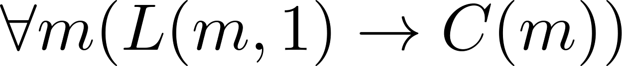
System Specification Example
Predicate logic is used for specifying properties that systems must satisfy.
For example, translate into predicate logic:
“Every mail message larger than one megabyte will be compressed.”
“If a user is active, at least one network link will be available.”
Decide on predicates and domains (left implicit here) for the variables:
Let L(m, y) be “Mail message m is larger than y megabytes.”
Let C(m) denote “Mail message m will be compressed.”
Let A(u) represent “User u is active.”
Let S(n, x) represent “Network link n is state x.
Now we have:

Slide 101
Nested Quantifiers

Slide 102
Outline
Nested Quantifiers
Order of Quantifiers
Translating from Nested Quantifiers into English
Translating Mathematical Statements into Statements involving Nested Quantifiers.
Translated English Sentences into Logical Expressions.
Negating Nested Quantifiers.

Slide 103
Nested Quantifiers
Nested quantifiers are often necessary to express the meaning of sentences in English as well as important concepts in computer science and mathematics.
Example: “Every real number has an additive inverse ” is ∀x ∃y(x + y = 0)
where the domains of x and y are the real numbers.
We can also think of nested propositional functions:
∀x ∃y(x + y = 0) can be viewed as ∀x Q(x) where Q(x) is ∃y P(x, y) where P(x, y) is (x + y = 0)

Slide 104
Thinking of Nested Quantification
Nested Loops
To see if ∀x∀yP (x,y) is true, loop through the values of x :
At each step, loop through the values for y.
If for some pair of x andy, P(x,y) is false, then ∀x ∀yP(x,y) is false and both the outer and inner loop terminate.
∀x ∀y P(x,y) is true if the outer loop ends after stepping through each x.
To see if ∀x ∃yP(x,y) is true, loop through the values of x:
At each step, loop through the values for y.
The inner loop ends when a pair x and y is found such that P(x, y) is true.
If no y is found such that P(x, y) is true the outer loop terminates as ∀x ∃yP(x,y) has been shown to be false.
∀x ∃y P(x,y) is true if the outer loop ends after stepping through each x.
If the domains of the variables are infinite, then this process can not actually be carried out.

Slide 105
Order of Quantifiers
Examples:
Let P(x,y) be the statement “x + y = y + x.” Assume that U is the real numbers. Then ∀x ∀yP(x,y) and ∀y ∀xP(x,y) have the same truth value.
Let Q(x,y) be the statement “x + y = 0.” Assume that U is the real numbers. Then ∀x ∃yP(x,y) is ? and ∃y ∀xP(x,y) is ?

Slide 106
Order of Quantifiers
Examples:
Let P(x,y) be the statement “x + y = y + x.” Assume that U is the real numbers. Then ∀x ∀yP(x,y) and ∀y ∀xP(x,y) have the same truth value.
Let Q(x,y) be the statement “x + y = 0.” Assume that U is the real numbers. Then ∀x ∃yP(x,y) is true, but ∃y ∀xP(x,y) is false.

Slide 107
Questions on Order of Quantifiers
Example 1: Let U be the real numbers,
Define P(x,y) : “x ∙ y = 0”
What is the truth value of the following:
∀x∀yP(x,y)
∀x∃yP(x,y)
∃x∀y P(x,y)
∃x ∃ y P(x,y)

Slide 108
Questions on Order of Quantifiers
Example 1: Let U be the real numbers,
Define P(x,y) : “x ∙ y = 0”
What is the truth value of the following:
∀x∀yP(x,y)
Answer: False
∀x∃yP(x,y)
Answer: True
∃x∀y P(x,y)
Answer: True
∃x ∃ y P(x,y)
Answer: True

Slide 109
Questions on Order of Quantifiers
Example 2: Let U be the non-zero real numbers,
Define P(x,y) : “x / y = 1”
What is the truth value of the following:
∀x∀yP(x,y)
∀x∃yP(x,y)
∃x∀y P(x,y)
∃x ∃ y P(x,y)

Slide 110
Questions on Order of Quantifiers
Example 2: Let U be the non-zero real numbers,
Define P(x,y) : “x / y = 1”
What is the truth value of the following:
∀x∀yP(x,y)
Answer: False
∀x∃yP(x,y)
Answer: True
∃x∀y P(x,y)
Answer: False
∃x ∃ y P(x,y)
Answer: True

Slide 111
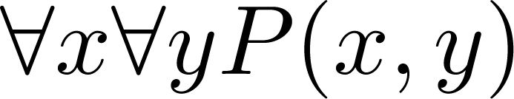
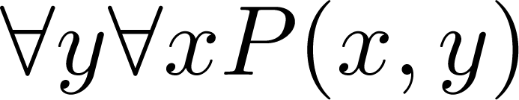
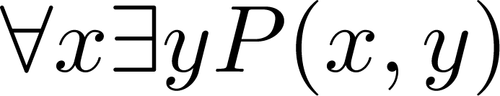
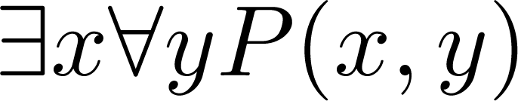
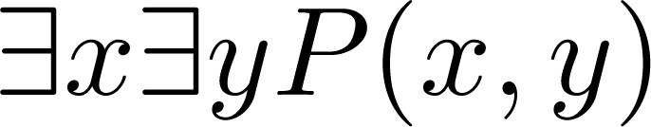
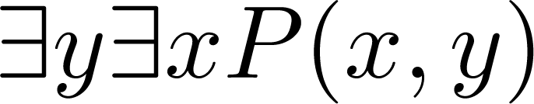
Quantifications of Two Variables
Statement | When True? | When False
 | P(x,y) is true for every pair x,y. | There is a pair x, y for which P(x,y) is false.
 | For every x there is a y for which P(x,y) is true. | There is an x such that P(x,y) is false for every y.
 | There is an x for which P(x,y) is true for every y. | For every x there is a y for which P(x,y) is false.
 | There is a pair x, y for which P(x,y) is true. | P(x,y) is false for every pair x,y

Slide 112
Translating Nested Quantifiers into English
Example 1: Translate the statement
∀x (C(x )∨ ∃y (C(y ) ∧ F(x, y)))
where C(x) is “x has a computer,” and F(x,y) is “x and y are friends,” and the domain for both x and y consists of all students in your school.
Example 2: Translate the statement
∃x∀y ∀z ((F(x, y)∧ F(x,z) ∧ (y ≠z))→¬F(y,z))

Slide 113
Translating Nested Quantifiers into English
Example 1: Translate the statement
∀x (C(x )∨ ∃y (C(y ) ∧ F(x, y)))
where C(x) is “x has a computer,” and F(x,y) is “x and y are friends,” and the domain for both x and y consists of all students in your school.
Solution: Every student in your school has a computer or has a friend who has a computer.
Example 2: Translate the statement
∃x∀y ∀z ((F(x, y)∧ F(x,z) ∧ (y ≠z))→¬F(y,z))
Solution: There is a student none of whose friends are also friends with each other.

Slide 114
Translating Mathematical Statements into Predicate Logic
Example: Translate “The sum of two positive integers is always positive” into a logical expression.

Slide 115
Translating Mathematical Statements into Predicate Logic
Example : Translate “The sum of two positive integers is always positive” into a logical expression.
Solution:
Rewrite the statement to make the implied quantifiers and domains explicit:
“For every two integers, if these integers are both positive, then the sum of these integers is positive.”
Introduce the variables x and y, and specify the domain, to obtain:
“For all positive integers x and y, x + y is positive.”
The result is:
∀x ∀ y ((x > 0)∧ (y > 0)→ (x + y > 0))
where the domain of both variables consists of all integers

Slide 116
Translating English into Logical Expressions Example
Example: Use quantifiers to express the statement “There is a woman who has taken a flight on every airline in the world.”

Slide 117
Translating English into Logical Expressions Example
Example: Use quantifiers to express the statement “There is a woman who has taken a flight on every airline in the world.”
Solution:
Let P(w,f) be “w has taken f ” and Q(f,a) be “f is a flight on a .”
The domain of w is all women, the domain of f is all flights, and the domain of a is all airlines.
Then the statement can be expressed as:
∃w ∀a ∃f (P(w,f ) ∧ Q(f,a))

Slide 118
Questions on Translation from English
Choose the obvious predicates and express in predicate logic.
Example 1: “Brothers are siblings.”
Example 2: “Siblinghood is symmetric.”
Example 3: “Everybody loves somebody.”
Example 4: “There is someone who is loved by everyone.”
Example 5: “There is someone who loves someone.”
Example 6: “Everyone loves himself”

Slide 119
Questions on Translation from English
Choose the obvious predicates and express in predicate logic.
Example 1: “Brothers are siblings.”
Solution: ∀x ∀y (B(x,y) → S(x,y))
Example 2: “Siblinghood is symmetric.”
Solution: ∀x ∀y (S(x,y) → S(y,x))
Example 3: “Everybody loves somebody.”
Solution: ∀x ∃y L(x,y)
Example 4: “There is someone who is loved by everyone.”
Solution: ∃y ∀x L(x,y)
Example 5: “There is someone who loves someone.”
Solution: ∃x ∃y L(x,y)
Example 6: “Everyone loves himself”
Solution: ∀x L(x,x)

Slide 120
Negating Nested Quantifiers
Example: Recall the logical expression developed three slides back:
∃w ∀a ∃f (P(w,f ) ∧ Q(f,a))
Part 1: Use quantifiers to express the statement that “There does not exist a woman who has taken a flight on every airline in the world.”
Solution: ¬∃w ∀a ∃f (P(w,f ) ∧ Q(f,a))
Part 2: Now use De Morgan’s Laws to move the negation as far inwards as possible.
Solution:
¬∃w ∀a ∃f (P(w,f ) ∧ Q(f,a))
∀w ¬ ∀a ∃f (P(w,f ) ∧ Q(f,a)) by De Morgan’s for ∃
∀w ∃ a ¬ ∃f (P(w,f ) ∧ Q(f,a)) by De Morgan’s for ∀
∀w ∃ a ∀f ¬ (P(w,f ) ∧ Q(f,a)) by De Morgan’s for ∃
∀w ∃ a ∀f (¬ P(w,f ) ∨ ¬ Q(f,a)) by De Morgan’s for ∧.
Part 3: Can you translate the result back into English?
Solution:
“For every woman there is an airline such that for all flights, this woman has not taken that flight or that flight is not on this airline”

Slide 121
Some Questions about Quantifiers
Can the order of quantifiers be switched?
Is this a valid equivalence?
Is this a valid equivalence?
Can the quantifiers be distributed over logical connectives?
Is this a valid equivalence?
Is this a valid equivalence?

Slide 122
Some Questions about Quantifiers
Can you switch the order of quantifiers?
Is this a valid equivalence?
Solution: Yes! The left and the right side will always have the same truth value. The order in which x and y are picked does not matter.
Is this a valid equivalence?
Solution: No! The left and the right side may have different truth values for some propositional functions for P. Try “x + y = 0” for P(x,y) with U being the integers. The order in which the values of x and y are picked does matter.

Slide 123
Some Questions about Quantifiers
Can you distribute quantifiers over logical connectives?
Is this a valid equivalence?
Solution: Yes! The left and the right side will always have the same truth value no matter what propositional functions are denoted by P(x) and Q(x).
Is this a valid equivalence?
Solution: No! The left and the right side may have different truth values. Pick “x is a fish” for P(x) and “x has scales” for Q(x) with the domain of discourse being all animals. Then the left side is false, because there are some fish that do not have scales. But the right side is true since not all animals are fish.

Slide 124
Section 3: Rules of Inference

Slide 125
Valid Arguments
An argument is a sequence of propositions.
All but the final proposition are called premises.
The last statement is the conclusion.
The Socrates Example
We have two premises:
“All men are mortal.”
“Socrates is a man.”
The conclusion is:
“Socrates is mortal.”
The argument is valid if the premises imply the conclusion.

Slide 126
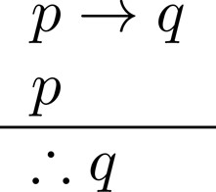

Arguments in Propositional Logic
Formal notation of an argument:
The premises are above the line
The conclusion is below the line
If it is raining then streets are wet
It is raining
Streets are wet
How do we know that this argument is valid?

Slide 127
Arguments in Propositional Logic
How do we know that this argument is valid?
Use truth tables
Tedious: table size grows exponentially with number of variables
Establish rules to incrementally build argument
p | q | p→q | p ∧ (p→q) | (p ∧ (p→q)) → q
T | T | T | T | T
T | F | F | F | T
F | T | T | F | T
F | F | T | F | T

Slide 128
Arguments in Propositional Logic
An argument form is an abstraction of an argument
It contains propositional variables
It is valid no matter what propositions are substituted into its variables, i.e.:
If the premises are p₁ ,p₂, …,p_{n} and the conclusion is q then
(p₁ ∧ p₂ ∧ … ∧ p_{n} ) → q is always T (a tautology)
If an argument matches an argument form then it is valid
Example:
( (p → q ) ∧ p ) → q is a tautology
Hence the following argument is valid:
( (if it’s raining → streets are wet) ∧ it’s raining) → streets are wet
Inference rules are simple argument forms used to incrementally construct more complex argument forms

Slide 129
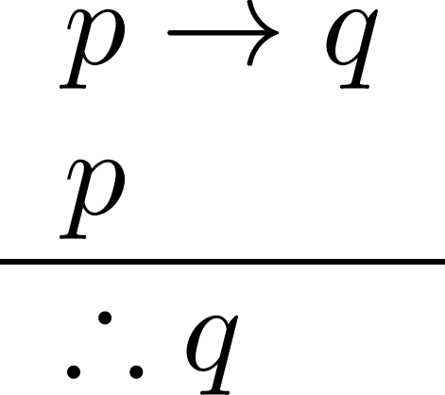
Modus Ponens
Corresponding Tautology:
(p ∧ (p →q)) → q
Example:
Let p be “It is snowing.”
Let q be “I will study math.”
“If it is snowing then I will study math.”
“It is snowing.”
“Therefore I will study math.”

Slide 130
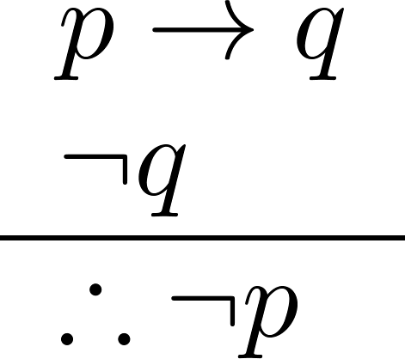
Modus Tollens
Corresponding Tautology:
(¬q ∧ (p →q)) → ¬p
Example:
Let p be “it is snowing.”
Let q be “I will study math.”
“If it is snowing, then I will study math.”
“I will not study math.”
“Therefore, it is not snowing.”

Slide 131
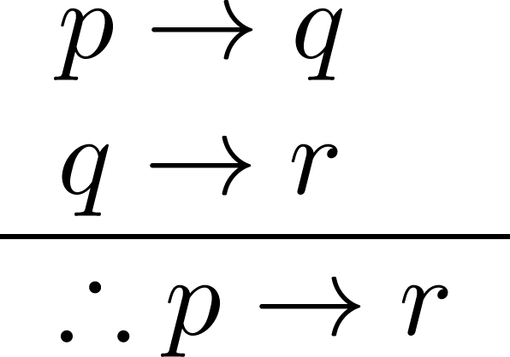
Hypothetical Syllogism
Corresponding Tautology:
((p →q) ∧ (q→r)) → (p→r)
Example:
Let p be “It snows.”
Let q be “I will study math.”
Let r be “I will get an A.”
“If it snows, then I will study math.”
“If I study math, then I will get an A.”
“Therefore, if it snows, I will get an A.”

Slide 132
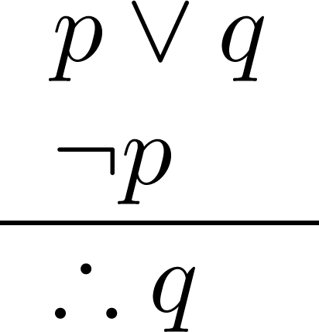
Disjunctive Syllogism
Corresponding Tautology:
(¬p ∧ (p ∨q)) → q
Example:
Let p be “I will study math.”
Let q be “I will study literature.”
“I will study math or I will study literature.”
“I will not study math.”
“Therefore, I will study literature.”

Slide 133
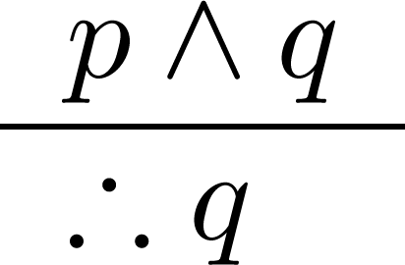
Simplification
Corresponding Tautology:
(p∧q) → q
Example:
Let p be “I will study math.”
Let q be “I will study literature.”
“I will study math and literature”
“Therefore, I will study math.”

Slide 134
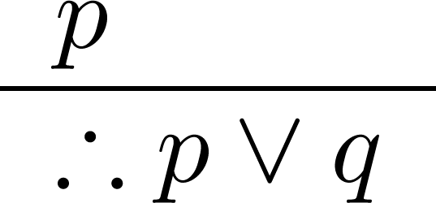
Addition
Corresponding Tautology:
p → (p ∨q)
Example:
Let p be “I will study math.”
Let q be “I will visit Las Vegas.”
“I will study math.”
“Therefore, I will study math or I will visit Las Vegas.”

Slide 135
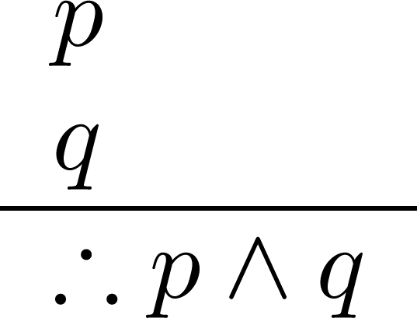
Conjunction
Corresponding Tautology:
((p) ∧ (q)) →(p ∧ q)
Example:
Let p be “I will study math.”
Let q be “I will study literature.”
“I will study math.”
“I will study literature.”
“Therefore, I will study math and literature.”

Slide 136

Resolution
Corresponding Tautology:
((¬p ∨ r ) ∧ (p ∨ q)) → (q ∨ r)
Example:
Let p be “I will study math.”
Let r be “I will study literature.”
Let q be “I will study physics.”
“I will not study math or I will study literature.”
“I will study math or I will study physics.”
“Therefore, I will study physics or literature.”

Slide 137
Valid Arguments
Example: Given these hypotheses:
“It is not sunny this afternoon and it is colder than yesterday.”
“We will go swimming only if it is sunny.”
“If we do not go swimming, then we will take a canoe trip.”
“If we take a canoe trip, then we will be home by sunset.”
Construct a valid argument for the conclusion:
“We will be home by sunset.”
Solution:
Choose propositional variables:
p: “It is sunny this afternoon.”
q: “It is colder than yesterday.”
r: “We will go swimming.”
s: “We will take a canoe trip.”
t: “We will be home by sunset.”
Translate into propositional logic
¬p ∧ q
r → p
¬r → s
s → t
∴ t

Slide 138

Valid Arguments
3. Construct the Valid Argument
¬p ∧ q
r → p
¬r → s
s → t
∴ t
Notes:
Note that a truth table would have 32 rows since we have 5 propositional variables.

Slide 139
Common Fallacies: Affirming the conclusion
This confuses necessary and sufficient conditions.
Example:
If people have the flu, they cough.
Alison is coughing.
Therefore, Alison has the flu.
This argument is not valid:
Other things, such as asthma, can cause someone to cough.
Having the flu is a sufficient condition for coughing, but it is not necessary

Slide 140
Common Fallacies: Denying the hypothesis
This also confuses necessary and sufficient conditions.
Example:
If it is raining outside, the sky is cloudy.
It is not raining outside.
Therefore, it is not cloudy.
This argument is not valid:
Skies can be cloudy without any rain.
Rain is a sufficient condition of cloudiness, but it is not necessary.

Slide 141

Universal Instantiation (UI)
If a predicate is true for all elements x in the domain then it is true for any specific element c
Example:
The domain consists of all dogs and Fido is a dog.
“All dogs are cuddly.”
“Therefore, Fido is cuddly.”
This rule allows us to remove a quantifier

Slide 142

Universal Generalization (UG)
If a predicate is true for any element c in the domain then it is true for all elements x
Example:
The domain consists of the dogs Fido, Spot, and Buddy.
“Fido is cuddly, Spot is cuddly, Buddy is cuddly.”
“Therefore, all dogs in the domain are cuddly.”
This rule allows us to introduce a quantifier

Slide 143

Existential Instantiation (EI)
If a predicate is true some element in the domain then it is true for some specific element c
Example:
“There is someone who got an A in the course.”
“Let’s call her c and say that c got an A”

Slide 144

Existential Generalization (EG)
If a predicate is true for a specific element c in the domain then there exists an element x for which it is true
Example:
“Michelle got an A in the class.”
“Therefore, there is someone who got an A in the class.”

Slide 145


Returning to the Socrates Example
1

Slide 146

Using Rules of Inference
Example: Construct a valid argument showing that:
“Someone who passed the first exam has not read the book.”
follows from the premises
“A student in this class has not read the book.”
“Everyone in this class passed the first exam.”
Solution: Let
C(x) denote “x is in this class”
B(x) denote “x has read the book”
P(x) denote “x passed the first exam”

Slide 147

Using Rules of Inference
Valid Argument:

Slide 148
Summary
The language of Propositional Logic is made of propositions, connectives, well formed compound propositions and truth values of propositions
Propositional equivalences can be established using truth tables or logical deduction employing rules of inference of Propositional Logic
Propositional Logic is complete and the rules of inference are consistent
Propositional Logic is decidable

Slide 149
Summary
Predicate Logic introduces variables and the power of quantification to propositional logic
The language of Predicate Logic consists of variables, quantifiers, connectives, predicates and truth values
Propositional equivalences can be established using logical deduction employing rules of inference of Predicate Logic
Predicate Logic is complete and consistent
Predicate Logic is not decidable

